Slide 1

General Meeting 12.01.2023

Slide 2
Status
File structures
ML Architectures
Data treatment
Writing
Whenever the data is done, It’s possible to produce results

Slide 3
DATa issues
Depth correlation
Vertical «noise»

Slide 4
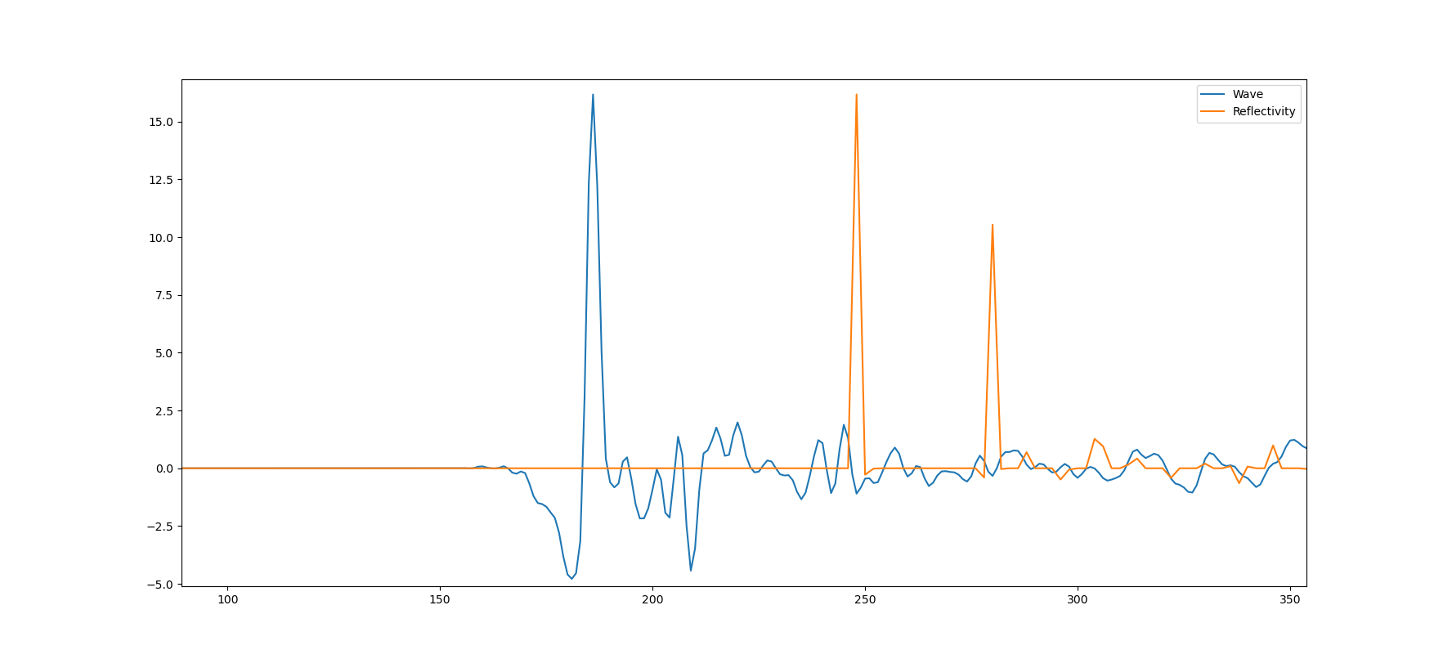
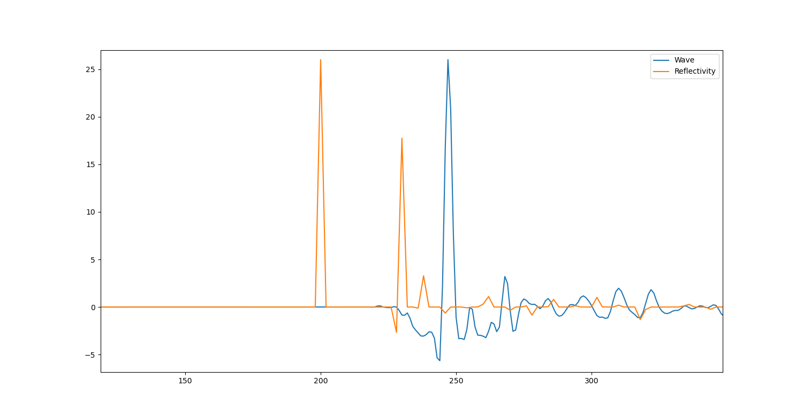
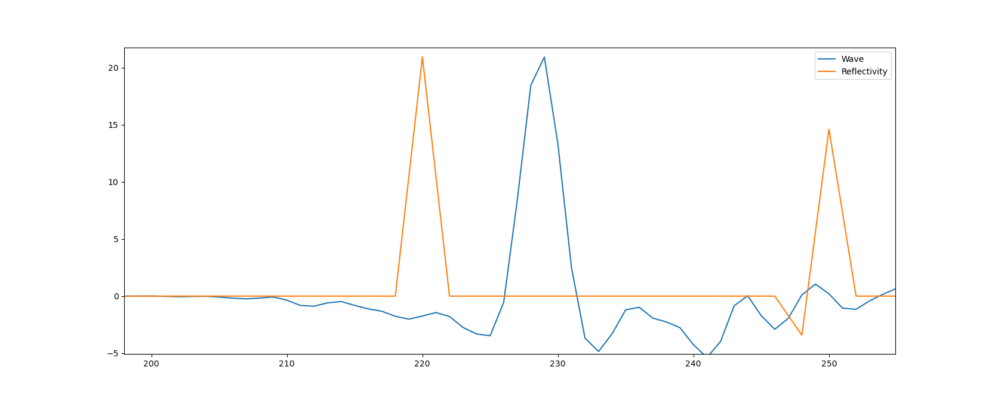
Reflectivity generally matches badly with the traces in the TNW dataset

Slide 5
Open source datasets
SEAM dataset
Used for modeling salt body petroleum reservoirs
Will have to model the seismic..
Just convolve the wavelet?
More sophisticated modeling?
Reverse time migration (used by Mustafa)

Slide 6
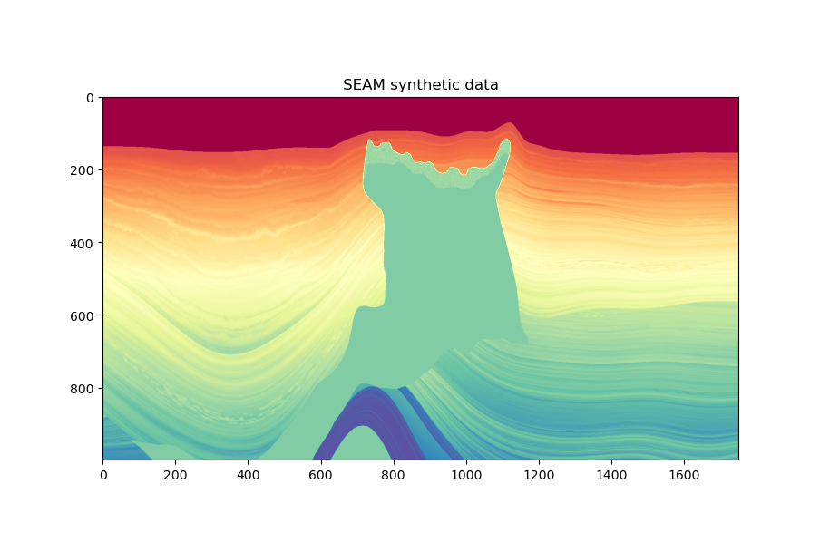

Slide 7
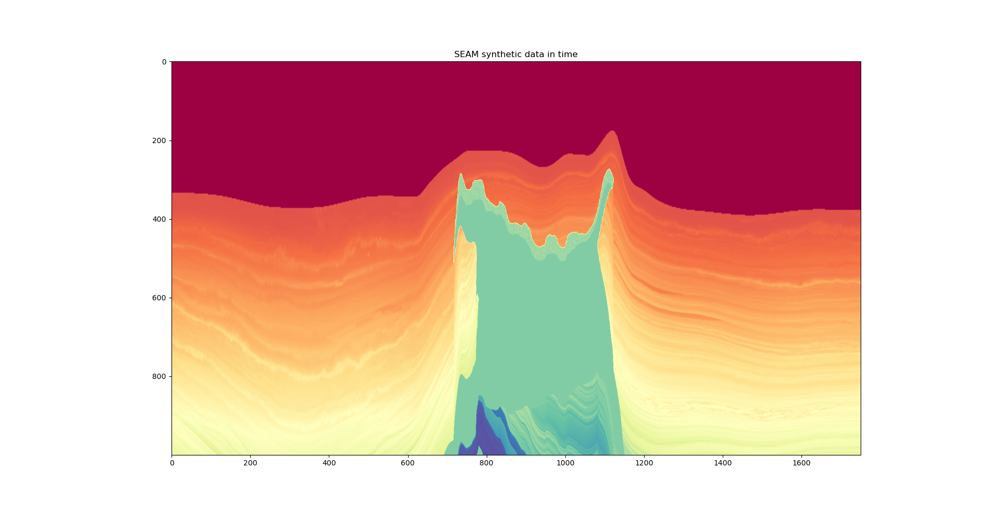

Slide 8
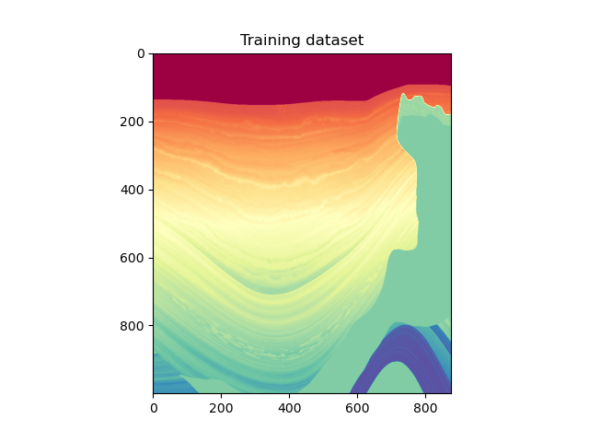
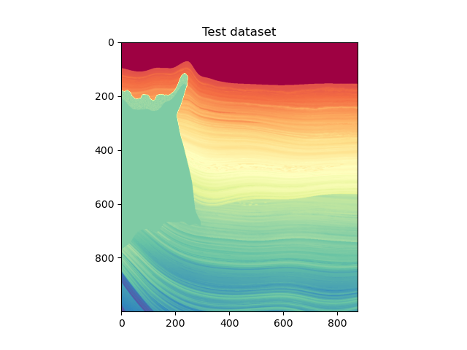

Slide 9
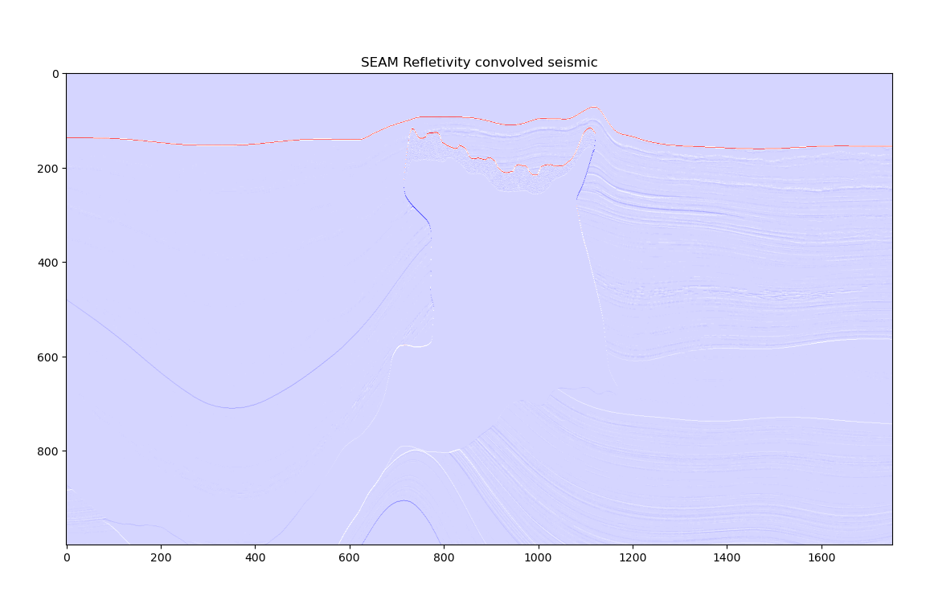

Slide 10

Noise to the data gets added through Variable encoding

Slide 11
Various models
 | Synthetic dataset [SEAM] |  | Real dataset [TNW]
Adversarial Training | Variable Autoencoding |  | Variable Autoencoding
 | Yes | No | Yes | No
2D | Yes | No | Yes | No

Slide 12
writing
For ML I’m using Tom Mitchell’s book «Machine Learning»
Also other sources from papers.

